Slide 1
Protecting UH Research
Office of the Vice President for Research and Innovation
U.S. Federal Focus on Research Security
Victoria Rivera
Director, Office of Research Compliance

Slide 2
Purpose
Understand the current U.S. federal government focus on protecting intellectual property through research security requirements for academia
“Some foreign governments, including those of the People’s Republic of China, Russia, and Iran, are working vigorously…to acquire, through both licit and illicit means, U.S. research and technology. There have been efforts to induce American scientists to secretively conduct research programs on behalf of foreign governments or to inappropriately disclose non-public results from research funded by U.S. government sources. This is unacceptable.”
Source: https://www.whitehouse.gov/wp-content/uploads/2022/01/010422-NSPM-33-Implementation-Guidance.pdf

Slide 3
Examples
The types of problems identified by the federal government include:
Undisclosed sources of foreign research support
Undisclosed conflicts of interest
Sharing grant proposals and research data with foreign entities
Duplicative funding
Overcommitment and “dishonesty after-the-fact”

Slide 4
White House focus on research security
Trump Administration
2019: OSTP-led initiative to coordinate federal research policies
2021: National Security Presidential Memorandum 33 (NSPM-33)
Biden Administration
2022: Guidance for implementing NSPM-33
Federal sponsoring agencies to develop model grant application forms, and
Clear and effective rules for ensuring research security and researcher responsibilities
Notes:
During its final week in office, Trump admin issued NSPM-33 to strengthen government support R&D against foreign government interference and exploitation while maintaining an open environment to foster research discoveries and innovation that benefit the nation and our world.
NSPM-33:
Enhance Awareness of Research Security Risks and Protections.
Strengthen Disclosure Requirements and Processes.

Slide 5
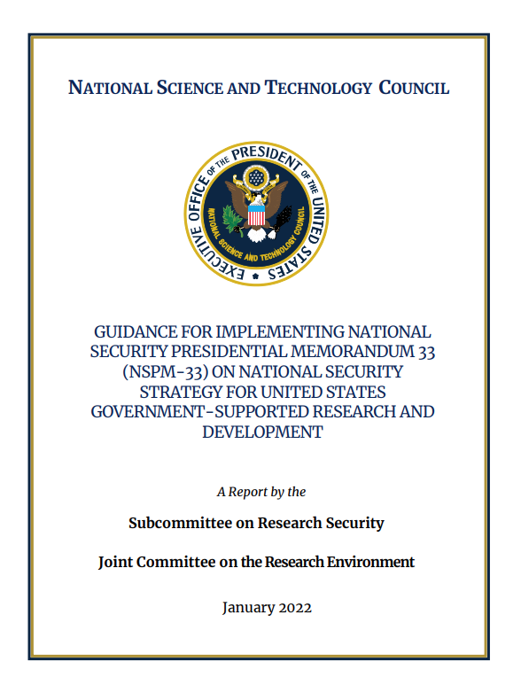
NSPM-33
Issues guidance to federal sponsoring agencies:
Disclosure Requirements and Standardization
Digital Persistent Identifiers
Consequences for Violation of Disclosure Requirements
Information Sharing
Research Security Programs

Slide 6
NSPM-33: Standardization of Disclosure Requirements
Nov 2023 Update:
Current Status:
Common disclosure forms have been developed for:
Biographical Sketch, and
Current and Pending (Other) Support
The Common Disclosure forms were published on 11/1/23.
The forms include individual certifications for disclosure accuracy and completeness.
Also includes updated Definitions (Nov 2023)
NSF will implement these forms with the PAPPG 24-1
Notes:
In the 2023 PAPPG, NSF implemented a harmonized disclosure format and will revise it based on feedback.

Slide 7
NSPM-33: Standardization of Disclosure Requirements
CURRENT AND PENDING (OTHER) SUPPORT COMMON FORM
November 1, 2023
“Consistent with NSPM-33, individuals are required to disclose contracts associated with participation in programs sponsored by foreign governments, instrumentalities, or entities, including foreign government-sponsored talent recruitment programs. Further, if individuals receive direct or indirect support that is funded by a foreign government-sponsored talent recruitment program, even where the support is provided through an intermediary and does not require membership in the foreign government-sponsored talent recruitment program, that support must be disclosed. Individuals must also report other foreign government sponsored or affiliated activities. In accordance with 42 USC § 19232, individuals are prohibited from being a party in a malign foreign talent recruitment program.”
Notes:
In the 2023 PAPPG, NSF implemented a harmonized disclosure format and will revise it based on feedback.

Slide 8
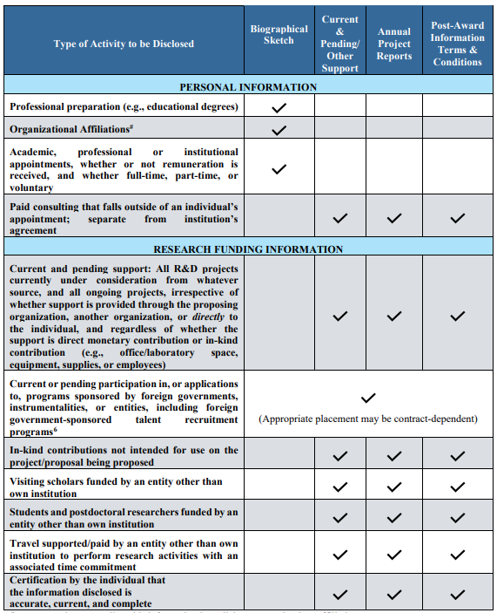
NSPM-33: Standardization of Disclosure Requirements
A table entitled, NSPM-33 Implementation Guidance Pre- and Post-award Disclosures Relating to the Biographical Sketch and Current and Pending (Other) Support1 has been created to provide helpful reference information regarding pre-award and post-award disclosures. The table includes the types of activities to be reported, where such activities must be reported in the application, as well as when updates are required in the application and award lifecycle. A final column identifies activities that are not required to be reported.

Slide 9
NSPM-33: Consequences for Violation of Disclosure Requirements
Serious potential consequences for the University:
Rejection of an R&D application
Preserving an award, but requiring removal of certain individuals
Suspension or termination of an R&D award
Suspension or denial of Title IV funds by the Department of Education (resulting in denial of federal student aid)
Alert other federal agencies of the non-compliance

Slide 10
NSPM-33: Research Security Program
Certification from the university that a research security program has been implemented with four elements:
Cybersecurity
Foreign travel security
Research security training
Export control training, as appropriate
Appoint a Research Security point of contact (POC)

Slide 11
Extramural Disclosure Training (EDT)
Effective October 1, 2023
EDT is required for PIs, investigators and other senior/key personnel on UH extramural requests for funding (grant applications) submitted through myGRANT
Take the course in Laulima
More information and link to course at: https://research.hawaii.edu/ors/training/

Slide 12
Internal and External Disclosures
Disclosures to the University (Internal)
Conflict of Interest (COI) disclosure
Conflict of Commitment (COC) disclosure
Intellectual property and inventions disclosure
myGRANT Proposal Development Questionnaire
Disclosures to Sponsors (External)
Biographical Sketch – affiliation or appointment disclosure
Current and Pending Support – external support disclosure
Illustration by Freepik Storyset

Slide 13
Disclosures to the University
Conflict of Interest (COI) disclosure
Conflict of Commitment (COC) disclosure
Intellectual property and inventions disclosure

Slide 14
UH COI Policies
UH Executive Policy 12.214: Conflicts of Interest and Commitment (http://go.hawaii.edu/Pgx)
UH Administrative Policy 12.304: Procedures for Disclosing and Addressing Conflicts of Interest Related with Extramurally-Funded Activities (http://go.hawaii.edu/2gP)
UH Administrative Policy A5.504: Procedures for Disclosing and Addressing Conflicts of Interest and Commitment (http://go.hawaii.edu/Pgk)

Slide 15
Conflicts of Interest (COI)
What is a conflict of interest?
A conflict of interest refers to a situation in which an employee’s financial, professional, or other personal interests may influence, or appear to influence, the employee’s judgement in fulfilling their responsibilities to UH.

Slide 16
Conflicts of Interest (COI)
Employee’s Responsibility for Disclosure
“Employees” include both UH and RCUH employees.
Individuals who accept employment at UH are responsible for disclosing any significant financial interest (SFI) and any other potential or actual conflict of interest (COI).
Failure to disclose a conflict of interest, or failure to adequately resolve a conflict when so directed, may be grounds for disciplinary action up to and including termination of employment.
Notes:
“Employees” include both UH and RCUH employees.

Slide 17
Conflicts of Interest (COI)
Who needs to submit a COI disclosure?
Faculty
Administrators
Investigators and key personnel involved in extramural proposals and funded activities
Individuals who act as agents of UH in the use or procurement of UH facilities and resources
This includes full-time and part-time employees, compensated or not, at UH and RCUH.

Slide 18
Conflicts of Interest (COI)
Which COI disclosure form do I complete?
UH currently utilizes two (2) COI forms for use by different employees:
rCOI disclosure form
Kuali Build (KB) disclosure form

Slide 19
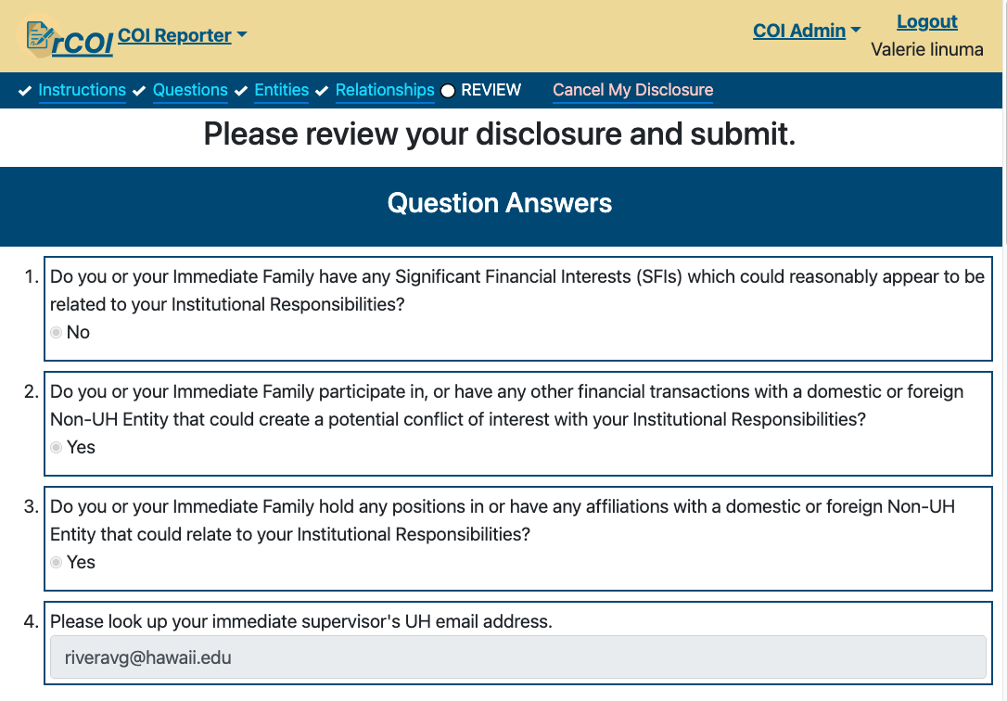
Conflicts of Interest (COI)
rCOI Disclosure form
Investigators and senior/key personnel named on extramural proposals and awards must submit their COI disclosure form through the rCOI system.
Note: myGRANT access is not required
to complete the rCOI form
https://mygrant.ors.hawaii.edu/rCOI

Slide 20
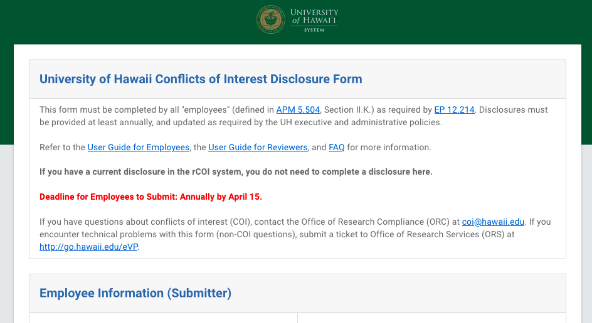
Conflicts of Interest (COI)
KB COI Disclosure form
Employees NOT involved in extramural projects should submit their COI disclosure form in Kuali Build.
This replaces the “paper” form from UH AP A5.504.
https://research.hawaii.edu/orc/kbcoi

Slide 21
Conflicts of Interest (COI)
When are COI disclosures due?
rCOI Due:
Upon hiring new employees
Every 12 months
Within 30 days of any changes
Active rCOI disclosures for all investigators and key personnel are checked for all proposal submissions and awards being processed!
KB Due:
Upon hiring new employees
Due annually on April 15th
Within 30 days of any changes

Slide 22
Conflicts of Interest (COI)
What must be disclosed?
An employee must disclose any Significant Financial Interest (SFI) of the employee and their immediate family*
and
other conflicts of interest that are or may appear to be related to their institutional responsibilities.
* Immediate family includes spouse, domestic partner, and dependent children.

Slide 23
Significant Financial Interests (SFIs)
Any of the following received in the past 12 months from Non-UH entities, including:
1. Remuneration (e.g., income, honoraria, payment for service) in excess of $5,000, aggregated per entity;
2. Equity interests (e.g., stock):
A. For publicly traded entities: value in excess of $5,000, aggregated per entity
B. For non-publicly traded entities: ANY value;
3. Royalties/income from intellectual property (e.g., patents, copyrights or trademarks) not partially licensed to and/or owned by UH;
4. Sponsored Travel – applicable only to PHS-funded investigators: Reimbursement or sponsorship for travel/lodging costs in excess of $5,000 aggregated per entity.
Non-UH entities include both domestic and FOREIGN individuals, organizations and government agencies.

Slide 24
Internal COI Disclosure Examples
Income, reimbursement or sponsorship of travel by a foreign (non-U.S.) government agency, foreign institution of higher education or foreign research entity.
Compensation for outside (non-U.S.) consulting, service or other related work.
Compensation or honoraria received from a foreign university for a guest lecture or seminar.
Equity or ownership in entities that could reasonably appear as related to UH Institutional Responsibilities.
Equity or ownership in entities that conduct business with UH.
Executive positions, board members or advisory roles (paid or unpaid).
Employment of UH staff or students in an entity for which an SFI exists.

Slide 25
What is excluded from disclosure?
Income from seminars, lectures, teaching engagements, or service on an advisory committee or review panel for a U.S. federal, state or local government agency, or U.S. institution of higher education.
Reimbursement or sponsorship of travel by a government agency or U.S. institution of higher education.
Salary, royalties or intellectual property right payments from UH.
Income from investment vehicles (e.g., mutual funds and retirement accounts) over which there is no direct control over investment decisions.

Slide 26
Important Note
When reporting your involvement with external (non-UH) entities, you MUST disclose your relationships with both domestic and FOREIGN organizations, governments and individuals.
When in doubt, report!
Illustration by Freepik Storyset

Slide 27
UH Conflict of Commitment Policies
Board of Regents Policy (RP) 9.207: Outside Employment (http://go.hawaii.edu/VH7)
Administrative Procedure (AP) A9.240: Record of Outside Employment (http://go.hawaii.edu/gmP)

Slide 28
Conflicts of Commitment (COC)
What is a COC?
A conflict of commitment arises when the non-university activities of an employee are substantial and overly demanding of the employee’s time and attention, and interfere with the employee’s obligations and responsibilities to UH.
Notes:
“Investigators” include both UH and RCUH employees.

Slide 29
Conflicts of Commitment (COC)
UH RP 9.207: Outside Employment – Section III.B.1
Members of the university faculty and staff are encouraged to promote the cultural and economic development of the state by utilizing their special abilities and skills in research, teaching, scholarly or artistic production, and consulting over and above the full requirements of the position to which they are appointed. Such additional supplementary activity must in no way interfere with the creditable performance of the primary obligation to the university. Outside employment must be of a professional nature, and it should contribute to the professional competence of the faculty member.

Slide 30
Conflicts of Commitment (COC)
UH AP A9.240: Record of Outside Employment
Requires completion of Form 50
Signed endorsement by chair and approval by dean/director
Deadline for completion of Form 50
The form must be filed at least one week prior to the beginning of each semester (or fiscal year, if appropriate) in which outside employment is contemplated, or, when there has been a change in plan previously proposed and approved. The form may be filed promptly at other times to accommodate situations where outside employment opportunity materializes on short notice.

Slide 31
Intellectual Property and Inventions
Promptly report all inventions to the Office of Innovation and Commercialization (OIC)
Submit disclosures through the myInvention portal at: https://inteum.otted.hawaii.edu/inteumweb/inventorportal (UH login required).
Once the disclosure is submitted, OIC will meet with you to discuss the invention and make a preliminary determination of licensing feasibility, novelty, potential applications and possible markets.

Slide 32
Disclosures to Sponsors

Slide 33
Sponsor-Specific Disclosures
Always follow specific instructions for disclosures required by extramural sponsors.
Biographical Sketch
List all positions, affiliations, and appointments
Including both foreign and domestic
Current and Pending Support
Also known as “Other Support,” include ALL sources of support for your research, including
Including both foreign and domestic

Slide 34
Sponsor-Specific Disclosures
Next we will highlight the disclosure requirements of several key federal sponsors:
National Institutes of Health (NIH)
National Science Foundation (NSF)
National Aeronautics and Space Administration (NASA)
Department of Energy

Slide 35
National Institutes of Health (NIH)
NIH is actively investigating multiple cases of possible inappropriate foreign interference.
As of August 2022, NIH reported 241 cases.
80% of cases found at least one serious compliance violation, including:
Undisclosed grant support
Undisclosed talent award
Undisclosed equity
Other undisclosed financial conflict of interest

Slide 36
NIH Biographical Sketch
List all academic, professional, scientific, or institutional appointments:
including both foreign and domestic
whether or not remuneration is received, and
whether full-time, part-time, adjunct, honorary, or voluntary.
Participation in programs sponsored by foreign governments, instrumentalities, or entities, including foreign government-sponsored talent recruitment programs.
“Consulting” is not specifically referenced in the instructions, but an example from NIH includes a consulting engagement.

Slide 37
NIH Other Support
List all resources made available to the researcher in support of and/or related to all of their research endeavors:
including both foreign and domestic,
whether or not support is provided through UH, another organization or directly to the individual,
regardless of whether or not they have monetary value.
Current or pending participation in programs sponsored by foreign governments, instrumentalities, or entities, including foreign government-sponsored talent recruitment programs.
In-kind contributions not intended for use on the project/proposal being proposed.
(continued on next slide)

Slide 38
NIH Other Support
(continued from prior slide)
Visiting scholars in labs funded by an external entity.
Students and postdoctoral researchers funded by an external entity.
Consulting that falls outside of an individual’s appointment; separate from institution’s agreement.
Travel supported/paid by an external entity to perform research activities with an associated time commitment.
Startup packages from organizations other than the proposing/home institution.

Slide 39
NIH Other Support
Signature: Each PD/PI or other senior key personnel must electronically sign their Other Support form prior to submission. This signature certifies that the statements are true, complete, and accurate.
Copies of Contracts: Effective January 2022, institutions must provide NIH with a copy of any foreign contract, grant, or other agreement specific to senior/key personnel foreign appointments, affiliations, and/or employment with a foreign institution.
Non-English contracts must be translated.
Timing of Disclosures: Requires reporting of Other Support at Just-In-Time (JIT). If Other Support is obtained after an award is made, it must be reported in a Research Performance Progress Report (RPPR), and recipients must address substantive changes by submitting a prior approval request to NIH.

Slide 40
NSF Disclosure Requirements
NSF released its latest Proposal & Award Policies & Procedures Guide (PAPPG 23-1) for proposals submitted or due on or after January 30, 2023.
Biographical Sketch
All academic, professional, or institutional appointments (includes any titled academic, professional, or institutional position whether or not remuneration is received, and whether full-time, part-time, or voluntary (including adjunct, visiting, or honorary).
Should include all current and domestic and foreign professional appointments outside of the individual’s academic, professional, or institutional appointments at the proposing organization.

Slide 41
NSF Disclosure Requirements
Current and Pending Support (Other Support)
Overarching rule: All resources made available to an individual in support of and/or related to all of his/her individual research efforts regardless of whether or not they have monetary value. Includes ongoing projects and proposals currently under consideration.
Senior personnel are required to disclose contracts associated with participation in programs sponsored by foreign governments, instrumentalities, or entities, including foreign government-sponsored talent recruitment programs.
If an individual receives direct or indirect support that is funded by a foreign government-sponsored talent recruitment program, even where the support is provided through an intermediary and does not require membership in the foreign government-sponsored talent recruitment program.
Note that non-disclosure clauses associated with these contracts are not acceptable exemptions from this disclosure requirement.

Slide 42
NASA Restriction
Since 2011, NASA has had restrictions on using NASA funds to enter into agreements “to participate, collaborate, or coordinate bilaterally in any way with China or any Chinese-owned company, at the prime recipient level or at any subrecipient level, whether the bilateral involvement is funded or performed under a no-exchange of funds arrangement.”
UPDATE: NASA recently released a new COI and COC disclosure policy for public comment (feedback was due by March 1, 2023). Will implement through a new term and condition in awards.

Slide 43
Consequences for Non-Disclosure
Submission of proposals through UH myGRANT requires the PI and senior/key personnel to certify that the information within the proposal is true, complete, and accurate.
The PI must further certify in myGRANT that Conflict of Interest requirements have been addressed.
When applying for federal funding, misrepresentations and/or omissions may be subject to individual prosecution and liability pursuant to, but not limited to, False Claims Act under 18 U.S.C. §§ 287, 1001, 1031 and 31 U.S.C. §§ 3729-3733.
When in doubt, report!

Slide 44
Resources
UH COI Resources page: https://research.hawaii.edu/orc/conflicts-of-interest/resources/
Submit UH COI Disclosure Form: https://research.hawaii.edu/orc/conflicts-of-interest/coi-disclosure/
More information in foreign interference in university research: https://research.hawaii.edu/orc/export-controls/foreign-influence-in-university-research/
NIH on foreign interference: https://grants.nih.gov/policy/foreign-interference.htm#:~:text=NIH%20and%20the%20biomedical%20research,information%20of%20the%20participating%20countries.

Slide 45
Contacts
Office of Research Compliance
Website: research.hawaii.edu/orc
Internal disclosure questions: COI@hawaii.edu
Office of Research Services
Website: research.hawaii.edu/ors
ORS directory: https://research.hawaii.edu/ors/ors-directory/
ORS Helpline: http://go.hawaii.edu/eVP

